Slide 1
ELEMENTARY STATISTICS, BLUMAN
Categorical Frequency Distribution
© 2019 McGraw-Hill Education. All rights reserved. Authorized only for instructor use in the classroom. No reproduction or further distribution permitted without the prior written consent of McGraw-Hill Education.

Slide 2
Objectives for this PowerPoint
Learn how to construct a Categorical frequency distribution

Slide 3
Data for Captured Characters
A researcher played a mobile device game for 2 hours. The objective of the game is to capture as many virtual characters as possible. The following table shows the list of characters captured after 2 hours of playing.
Plastic | Liquid | Wheat | Insect | Metal | Plastic | Insect
Insect | Plastic | Insect | Liquid | Wheat | Insect | Liquid
Wheat | Insect | Wheat | Plastic | Insect | Liquid | Insect
Metal | Wheat | Insect | Wheat | Insect | Plastic | Wheat
Plastic | Insect | Plastic | Plastic | Liquid | Insect | Plastic

Slide 4
Data
In this raw form, the data is not particularly useful. The data must be organized so that conclusions can be drawn from the data set.
We will construct a Categorical Frequency Distribution which is a table that uses classes and frequencies to organize the data.

Slide 5
Step 1
Step 1 – Make a table with headings:
Class
Tally
Frequency
Percent
In the class column, we will place the categories. In this case, it is the type of characters that were captured.
Class | Tally | Frequency | Percent
Plastic
Wheat
Insect
Metal
Liquid

Slide 6
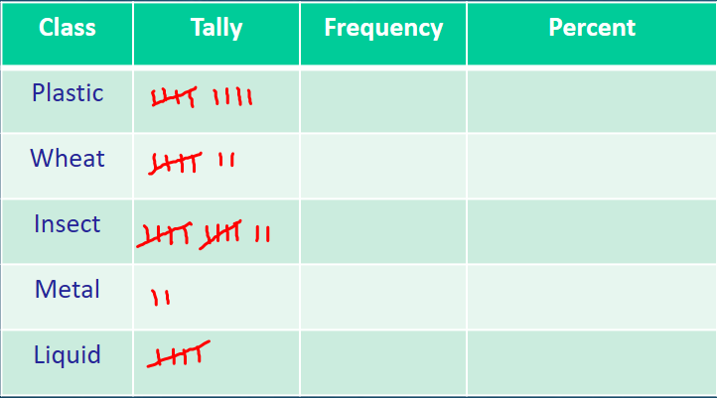
Step 2
Step 2 – Tally the data
Go back to the table and count the number in each category. There were 9 Plastic characters, 7 Wheat characters, 12 Insect characters, 2 Metal characters, and 5 Liquid characters.

Slide 7
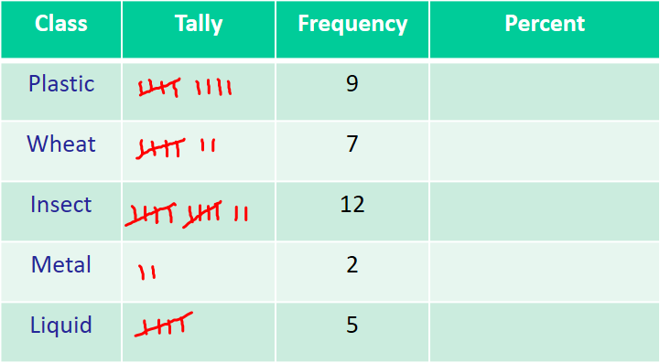
Step 3
Step 3 – Record the frequencies
In the frequency column place the number of each of the characters that were captured.

Slide 8
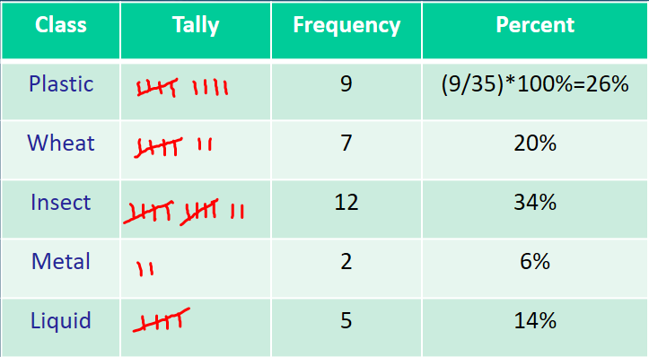
Step 4
Step 4 – Calculate and record the percentages
To calculate the percentage divide the frequency of each class by the size of the data set which is 35 and multiply by 100%. Always round to the closest percent.
For Plastic the calculation will be 9/35*100%. This calculation gives us a result of 26%. This means 26% of the characters captured were Plastic characters.
Continue this process for the other categories.

Slide 9
Use of Table
If we study the table, we can more easily see the distribution of the categories in the data set. For instance, the Insect category was most popular with 34% of the characters captured.

Slide 10
Summary
In this PowerPoint we learned how to construct a categorical frequency distribution.

